Slide 1
Redesigning a restaurant website using UD
(https://firstslice.org/)
Student Name:

Slide 2
Contents
Features of an accessible website
Web accessibility principles
Analysis and Implementation

Slide 3
Features of an accessible website
“The power of the web is in its universality. Access by everyone regardless of disability is an essential aspect” – Tim Berners Lee.
Web accessibility refers to the design and development of websites, tools and technologies, with the goal of enabling people to:
        Perceive, understand and navigate the web
        Contribute to the web
        With web accessibility correctly implemented, all people can access and use the web – the disabled, ageing people, people with slow internet connection, those accessing the web with different devices.
        The disabilities catered for by web accessibility include – auditory, cognitive, neurological, speech, and visual.

Slide 4
Web accessibility principles
The following concepts are what make an accessible website:
Content
Use text alternatives for non-text content, e.g. images
Content can be presented in different ways
Content is easier to see and understand
Navigation
Users should be able to navigate using keyboards
Users can easily navigate, find content and determine where they are.
Information on the website
Text should be readable and understandable
Robustness
The content on the website should be compatible with current and future tools

Slide 5
Analysis and implementation
Basing on the web accessibility requirements from W3 Web Accessibility site, the restaurant website lacks some accessibility features to make it accessible to all users.
More specifically, the following are the areas of focus:
Making the content more understandable and user friendly – the web pages content is not straight forward. The website content could be simplified
Visual : the colors used lack contrast in some sections.
Text: the website has a lot of text. The amount of text could be reduced and made more readable.
Images: Pictures on the site could include alternate text for people who cannot see.
Language: for people who speak and read other languages, the website does not cater for their languages.
Navigation of the website: navigation could be simplified further, and to also accommodate users who use keyboards for navigation. Sections of content could also be added for easier navigation.

Slide 6
Implementation
The following slides show the implementation plan to make the current website more accessible.

Slide 7
1. General layout
This section is concerned with examining the layout of the existing website, and finding ways of making it accessible

Slide 8
introduction
The current website has too many elements fitted on web pages
The content is also not split into sections for easier navigation using keyboards.
The layout is not easy to navigate

Slide 9
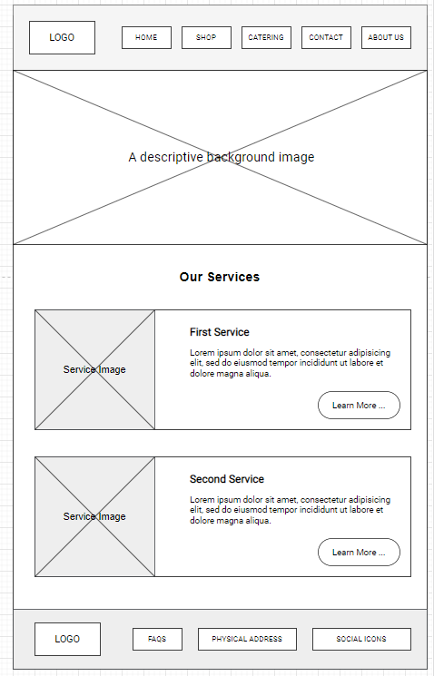
Redesigned solution
Key points:
Simplification of the layout to make it more understandable
Division of content into sections for easier navigation for people using keyboards.

Slide 10
2. Text
This section looks at the use of text, and how to make it more accessible.

Slide 11
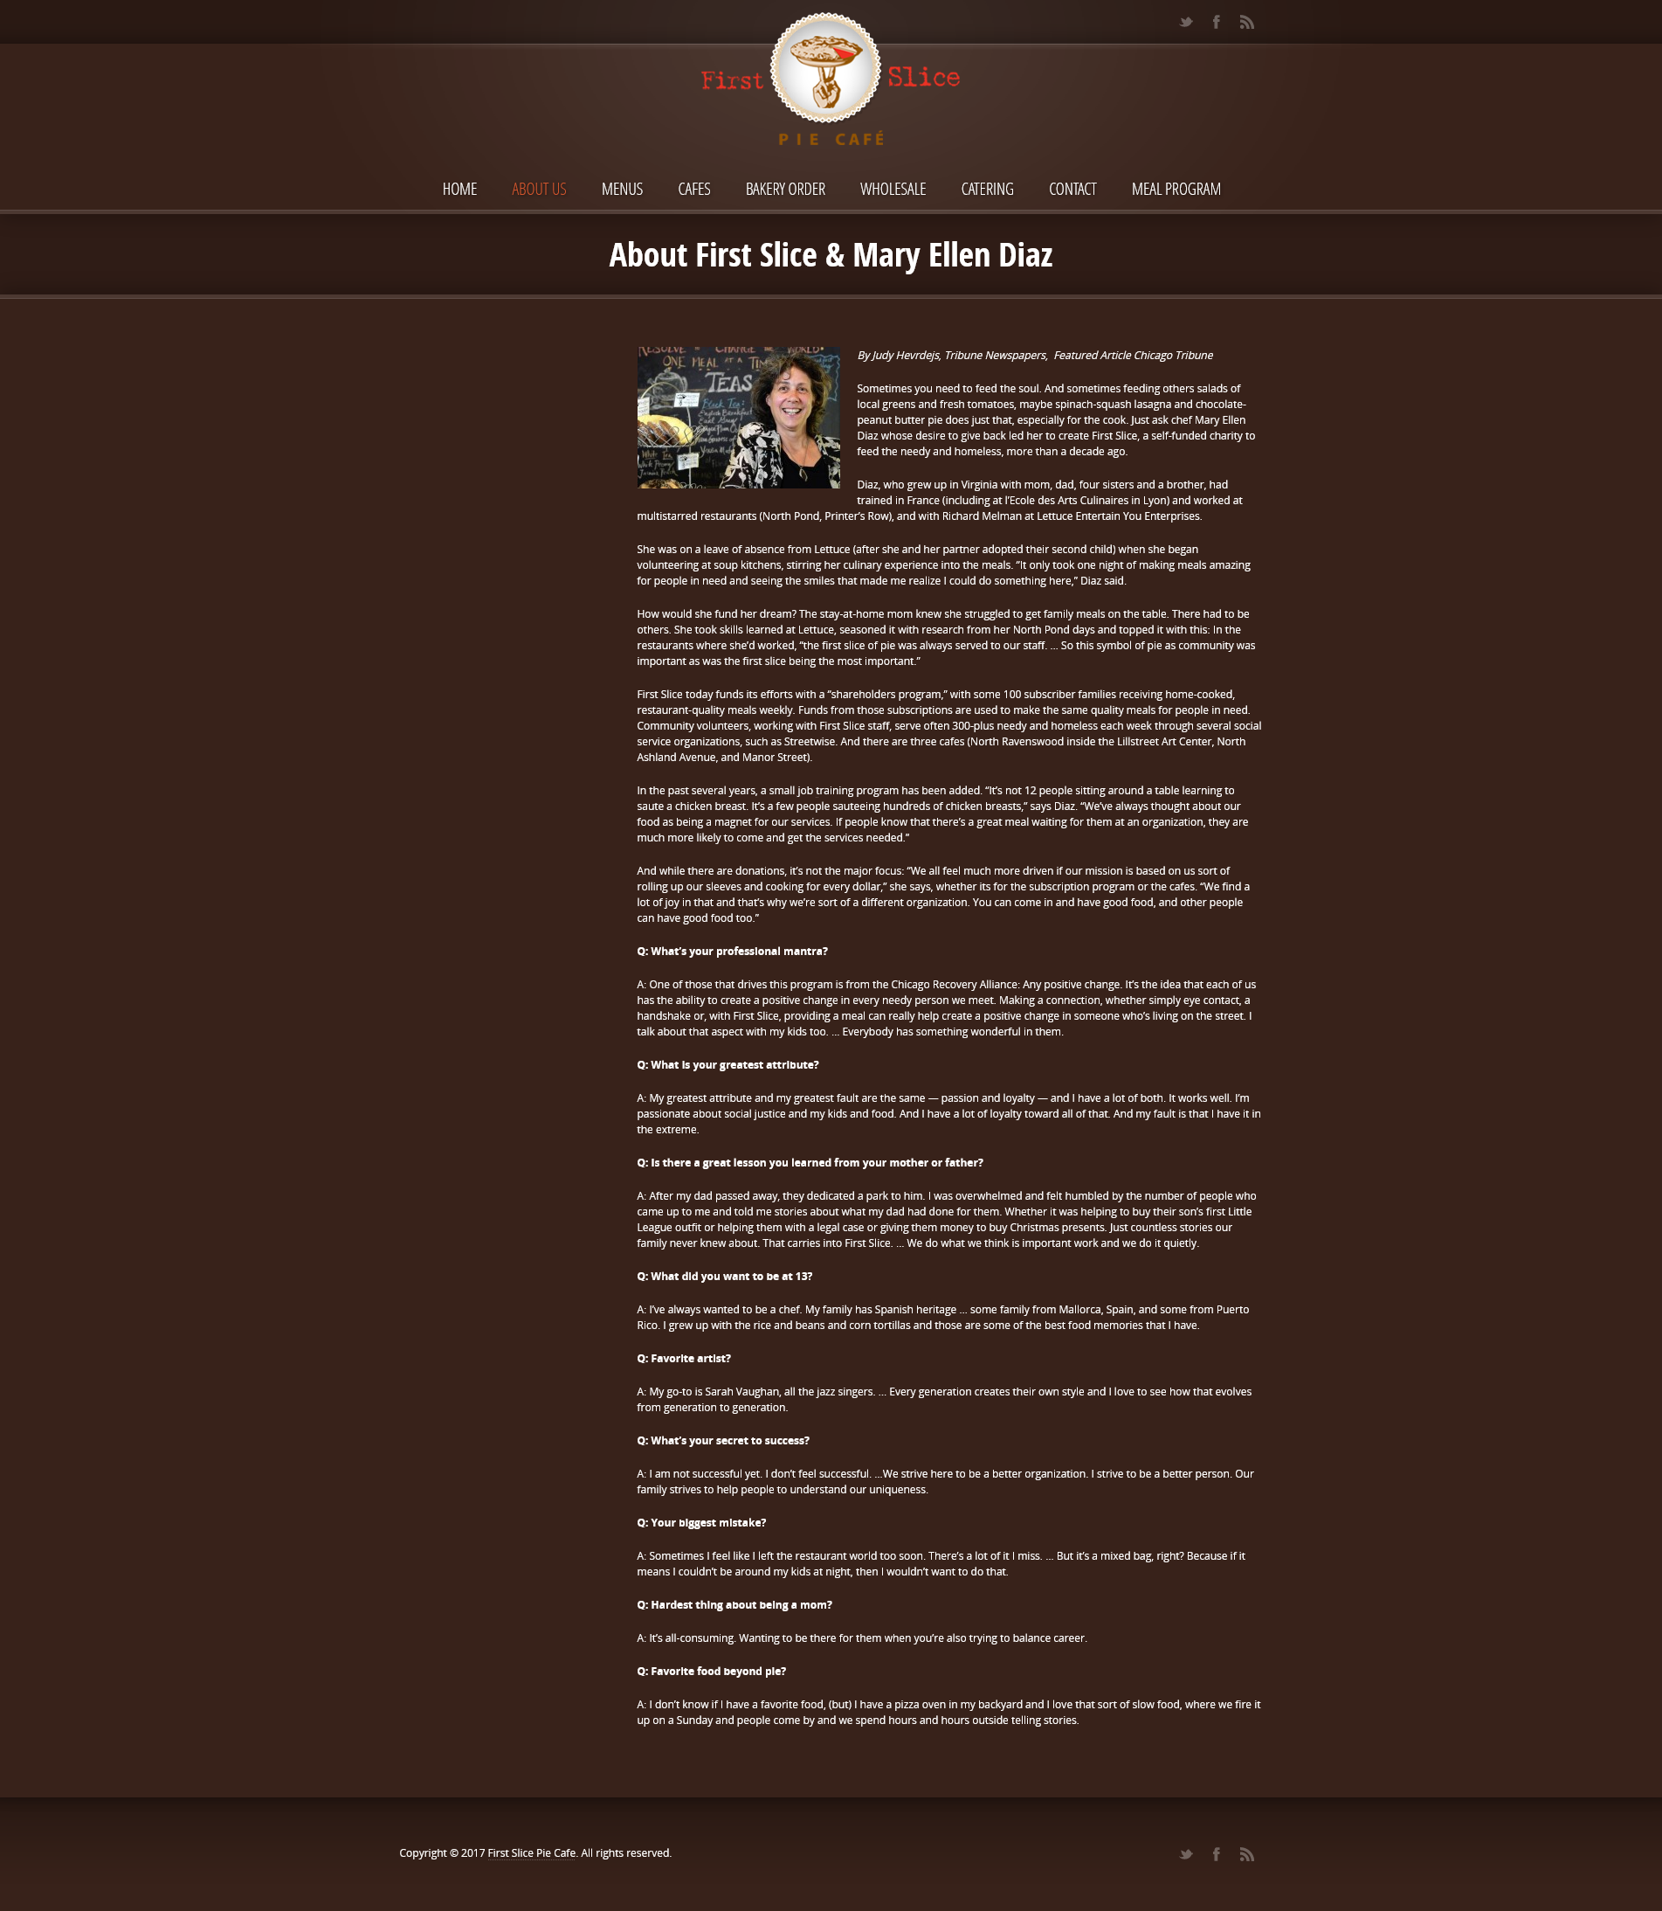
introduction
The current website has too much text, making it difficult to read
Also, there is no way to increase the font size to make it more readable for people who are visually impaired.
The text hierarchy has not been adhered to.
Some sections have very little contrast making text unreadable.

Slide 12
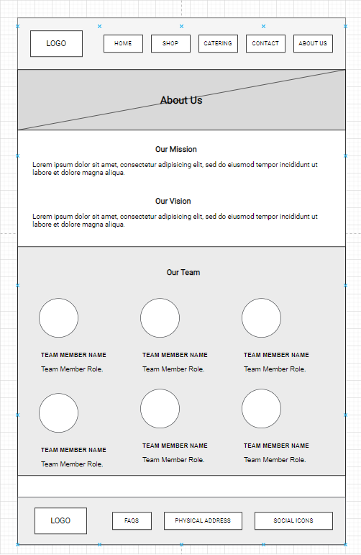
Redesigned solution
Key points:
Reduce text on the pages
Use a more readable font
Adhere to the text hierarchy – the high level headings are h1, while the lowest level headings are h6

Slide 13
3. Images and video
This section is about making images more accessible

Slide 14
Introduction
The current website can be made more accessible by adding alternate text to images through the ‘alt’ tag
Descriptions can be added to images to cater for those people who are visually impaired
Captions and taglines can also be added to pictures to improve accessibility.
The quality of images could be enhanced

Slide 15
4. Color
This section is all about making the current website more accessible using color

Slide 16
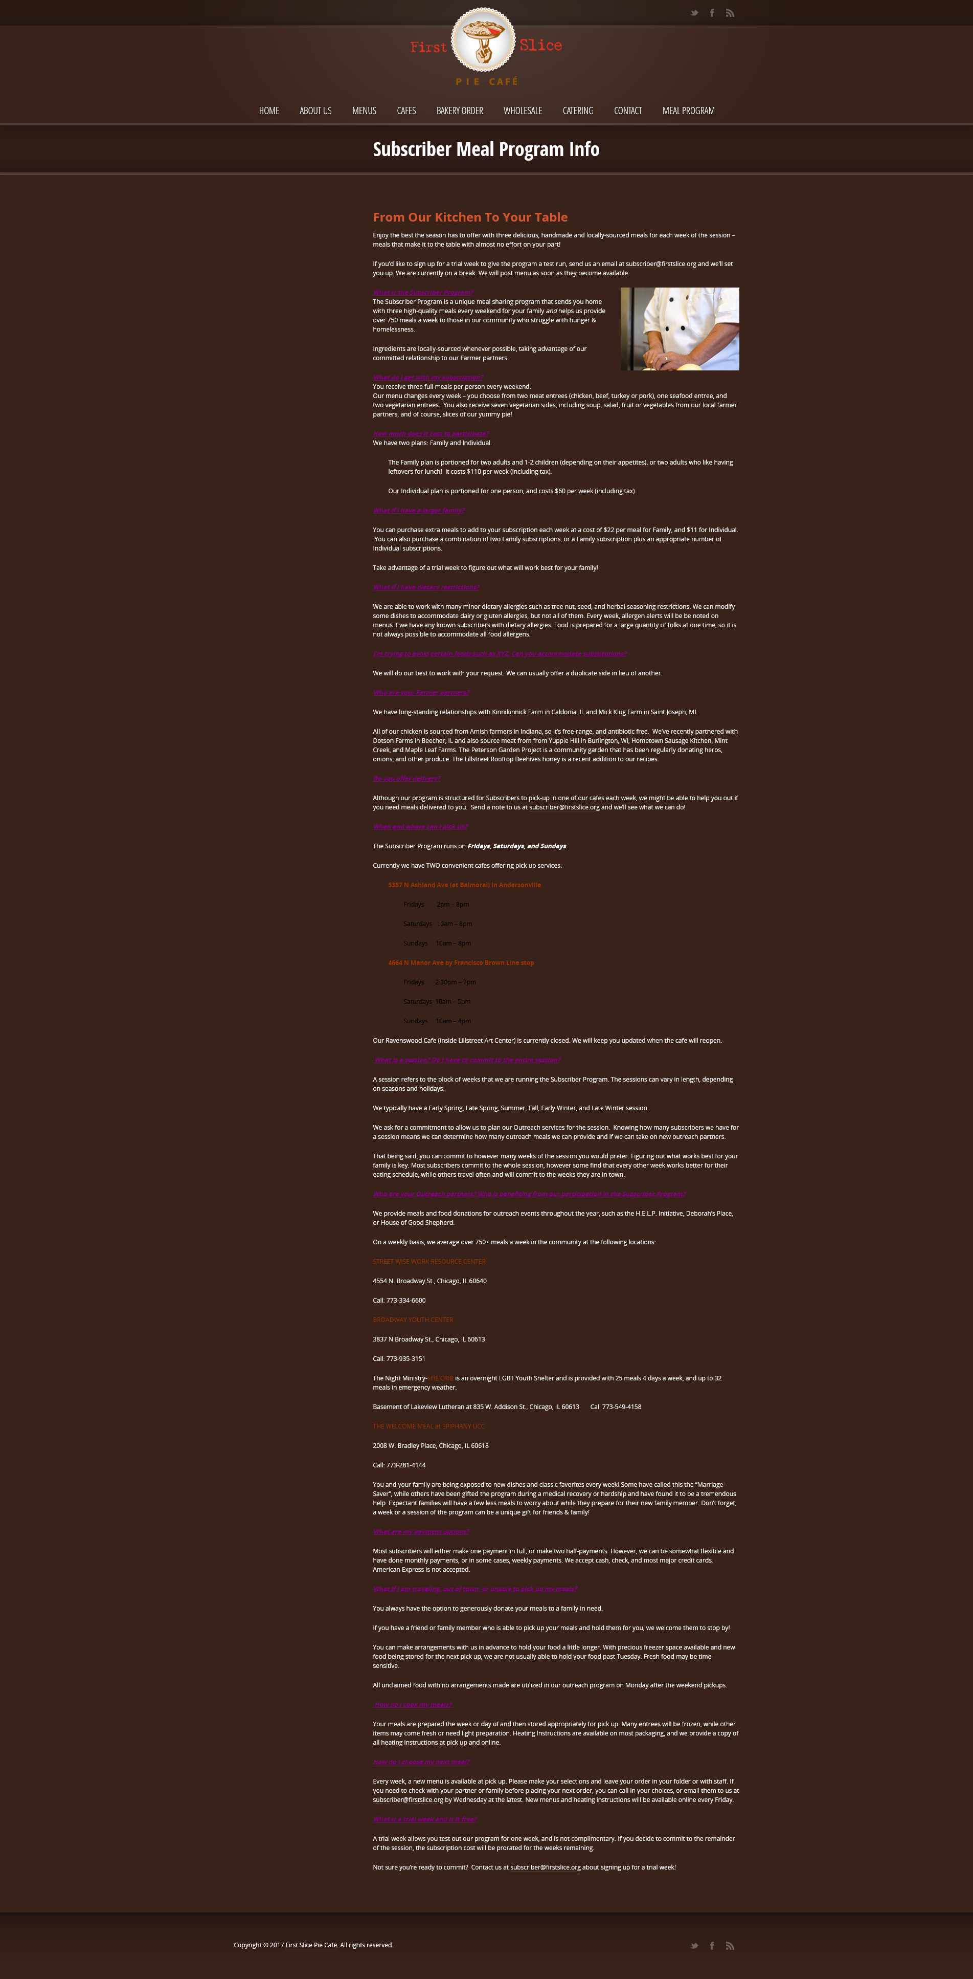
Introduction
The current website is monotonous.
The contrast between the background and foreground color could also be improved
Color could also be used to distinguish call to action buttons on the website to make it more accessible
Text is not readable on some sections because of poor contrast.

Slide 17
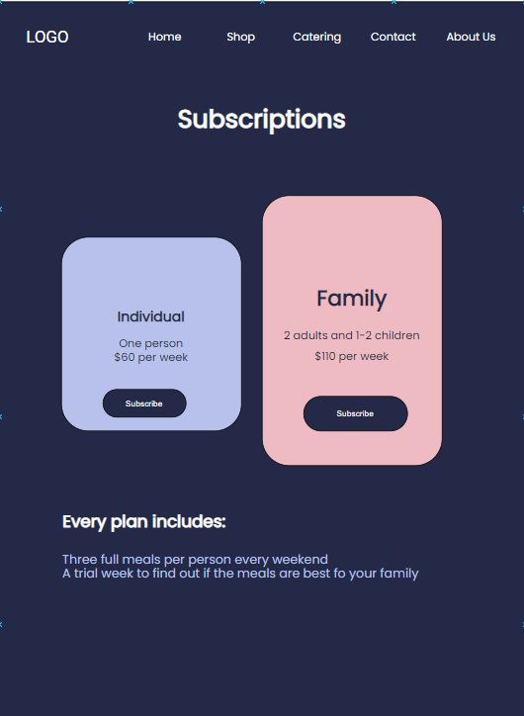
Redesigned solution
Key points
Simplified design
Use of color for distinguishing a call to action from normal content
Use of clear contrast to communicate the message

Slide 18
5. Language
This section examines how to use language to improve accessibility

Slide 19
Introduction
The current website does not allow the user to change language to their preferred one
Adding internationalization to the website will make it more accessible and easier to use across different regions of the world.
This way, a user can easily choose the language they desire to use on the website, or even translate.

Slide 20
Thank you!

Slide 21
References
https://www.w3.org/WAI/
https://www.w3.org/TR/coga-usable/#design_for_everyone
https://webaccess.berkeley.edu/resources/tips/web-accessibility

